Slide 1
QATAME
Quality Assurance Technical Assistance Monitoring & Evaluation

Slide 2
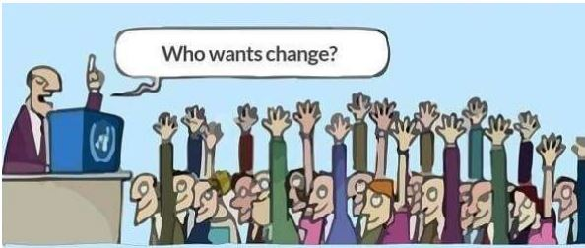

Slide 3
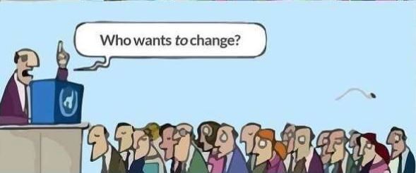

Slide 4
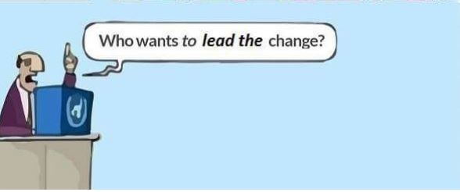

Slide 5
Terminal: At the end of the session the participants will be able to understand the importance of conducting QA, TA, and M&E in ensuring quality of development programs/interventions
Enabling: * Explain the process in doing quality assurance, providing technical assistance and conducting monitoring and evaluation * Practice quality assurance, providing technical assistance and conducting monitoring and evaluation

Slide 6
QATAME
is the subsystem for ensuring compliance to quality standards; providing supportive guidance (TA); and assessing progress and results of L&D programs (ME).
This subsystem provided processes for maintaining the efficiency, effectiveness, and sustainability of the L&D System.
It provides timely and supportive interventions towards continuous improvement in the implementation of the System.

Slide 7
Quality Assurance
ensuring compliance to quality standards;

Slide 8
Quality Assurance
ensuring compliance to quality standards;
checks on the conduct of L&D cycle activities (i.e., from needs assessment to delivery), and the outputs of these activities against a set of quality criteria.

Slide 9
Technical Assistance
Providing supportive guidance;

Slide 10
Technical Assistance
Providing supportive guidance;
is provided through feedback, advice, coaching or other interventions to address issues and improvement areas uncovered through QA.
This is consistent with QATAME’s developmental perspective, and focus on learning and support.
TA contributes to building the capacity of L&D implementers, and enhances the L&D program’s chances for successfully achieving desired results.

Slide 11
monitoring & Evaluation
Assessing progress and results of the L&D programs

Slide 12
monitoring & Evaluation
Assessing progress and results of the L&D programs
measures not just L&D activities and outputs but also the inputs necessary to carry out the activities and the outcomes and impacts resulting from L&D activities and outputs.

Slide 13
monitoring & Evaluation
- For monitoring and evaluation of L&D interventions, Kirkpatrick’s model of evaluation is adopted.
Level 1 – Reaction – the degree to which participants find the L&D intervention favorable, engaging and relevant to their jobs
Level 2 – Learning – the degree to which participants acquire the knowledge, skills, attitude, confidence and commitment based on their participation in the L&D intervention
Level 3 – Behavior – the degree to which participants apply what they have learned from the L&D intervention when they are back on the job
Level 4 – Results – the degree to which targeted outcome and impact objectives are achieved as a result on the L&D intervention

Slide 14
QATAME
-involves five key processes
1. Forming the QATAME teams
2. Formulating the QATAME plan
3. Developing or adapting QATAME tools
4. Conducting QATAME
5. Preparing QATAME Report

Slide 18
QATAME PRACTITIONERS COMPETENCY STANDARDS

Slide 19
L & D Designing

Slide 20
Key Elements: 1. TITLE Example of Title- Reading Festival (National Reading Month)

Slide 21
I. Project Title Reading Festival (National Reading Month) II. Participants All English and Filipino teachers Grade Chairman English coordinator Filipino coordinator Reading Coordinator All pupils (LSENs, Kinder to Grade 6) III. Venue and Date of Implementation Luis Francisco Elementary School November
ACTIVITY PLAN

Slide 22
lV. Rationale describes what the organization is doing and the role of the target participants in achieving the workplace development objectives (WDO)

Slide 23
The Department of Education (DepEd) has declared November as the National Reading Month. The celebration aims to support the k to 12 Basic Education Program, strengthen the Every Child A Reader Program making every Filipino a reader and to support the ten-point education agenda of the Aquino administration. All school officials and learning center administrators are enjoined to conduct activities suggested by DepEd. However, schools shall also be encouraged to hold other related activities other than on the suggested ones.
Example of Rationale :

Slide 24
V. Terminal objectives in the L & D Plan identify what the participants must be able to do as a result of the intervention.

Slide 25
At the end of the program, all pupils are expected to have participated in the various reading activities and develop their listening abilities, creativity and oral communication.
Example : Terminal objective

Slide 26
VI.1 Enabling objectives contribute to the achievement of terminal objective

Slide 27
Enabling objective breakdown the terminal objectives into major learning milestone that mark the participants progress or development towards the achievement of the terminal objectives.

Slide 28
1. Create various reading activities that encourage children to rekindle their interest in reading 2. Encourage school children to participate in the month-long reading activities 3. Hone the talents of school children in communication and arts through competitions
EXAMPLE: Enabling objectives

Slide 29
VII. TOTAL SUGGESTED BUDGET SOURCE OF FUND

Slide 30
VII. Total Suggested Budget Source of Fund Token for the Mystery Reader 150.00 MOOE Snacks for Judges 300.00 MOOE

Slide 31
Attachment: 1. TRAINING CONTENT and METHODOLOGIES: (Attach Training Matrix)

Slide 32
2. MANAGEMENT STRUCTURE (Attach List of Management Staff with Corresponding Committee Assignments

Slide 33
3. LIST OF TRAINERS

Slide 34
4. RESOURCE PACKAGE Training Materials (cases, videos, slide deck, etc. Readings for Participants Other Support Materials

Slide 35
http://ctb.ku.edu/en/table-of-contents/structure/strategic-planning/create-objectives/main http://www.nickols.us/work_objectives.pdf http://www.insperity.com/blog/5-steps-to-creating-employee-development-plans-that-truly-work/ https://prezi.com/-xf6ash2jy47/absorptive-capacity/ https://www.pahrodf.org.ph/resource-center/hrdf-outputs/job-aid-workplace-development-objectives-wdo.pdf https://www.ccl.org/articles/leading-effectively-articles/the-70-20-10-rule/ http://www.selfdirectedlearning.org/what-is-self-directed-learning

Slide 36
http://www.balancedscorecard.org/BSC-Basics/Strategic-Planning-Basics PG Aklan https://elearningindustry.com/apply-70-20-10-model-learning-development http://hr.ofm.wa.gov/workforce-data-planning/workforce-planning/step-3-identify-workforce-objectives

Slide 37
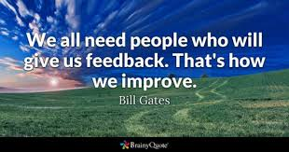
ACTIVITY:
Using Manila paper, write your project proposal.

